Slide 1
ROHIT KUMAR SAH
SUBJECT : ECONOMETRIC METHOD
SUBJECT CODE : AE 105
CENTRE FOR DEVELOPMENT STUDIES

Slide 2

PREDICTING COMPANY’S TURNOVER
USING LOGISTIC REGRESSION
The written file can be downloaded from the below link : file.pdf

Slide 3
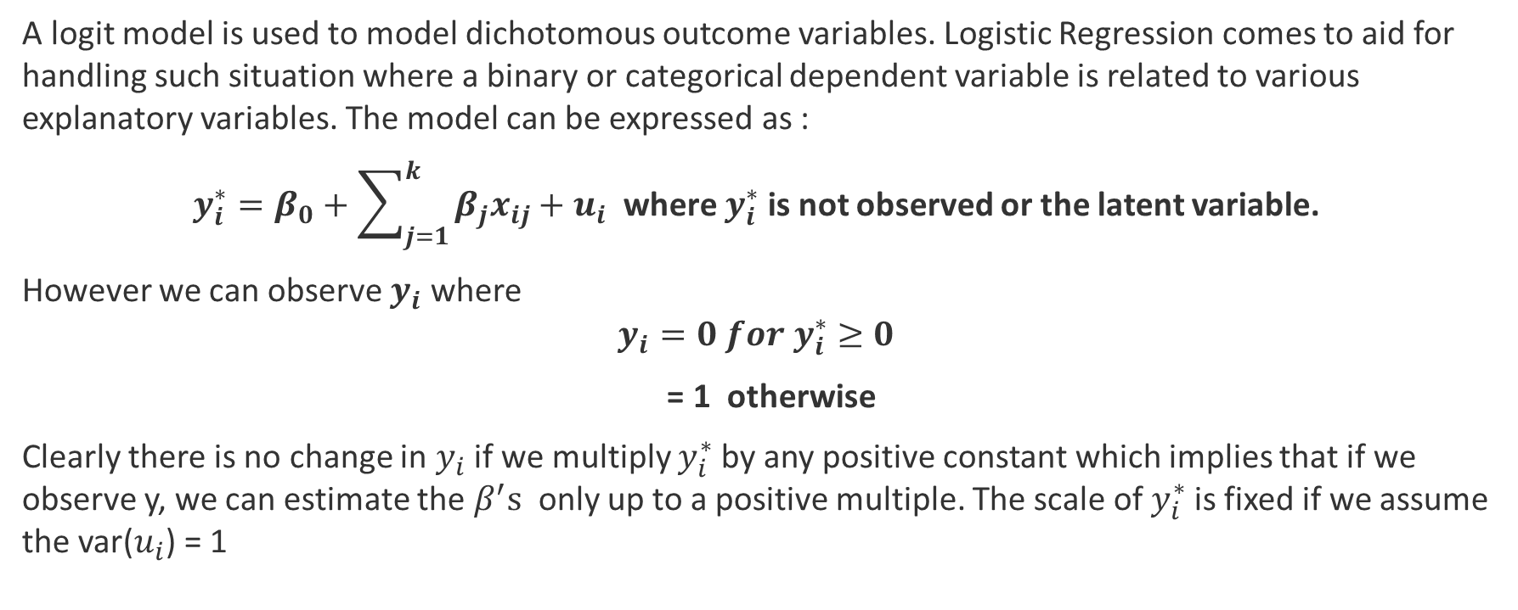
LOGIT MODEL
A logit model is used to model dichotomous outcome variables. Logistic Regression comes to aid for handling such situation where a binary or categorical dependent variable is related to various explanatory variables. The model can be expressed as :
$y_{i}^{∗}=β_{0}+\sum_{j=1}^{k}{β_{j}x_{ij}}+u_{i}$ where $y_{i}^{∗}$ is not observed or the latent variable.
However we can observe $y_{i}$ where
$$y_{i}=0 for{ y}_{i}^{∗}≥0$$
= 1 otherwise
Clearly there is no change in $y_{i}$if we multiply $y_{i}^{∗}$by any positive constant which implies that if we observe y, we can estimate the $β^{′}s$ only up to a positive multiple. The scale of $y_{i}^{∗}$is fixed if we assume the var($u_{i}$) = 1

Slide 4
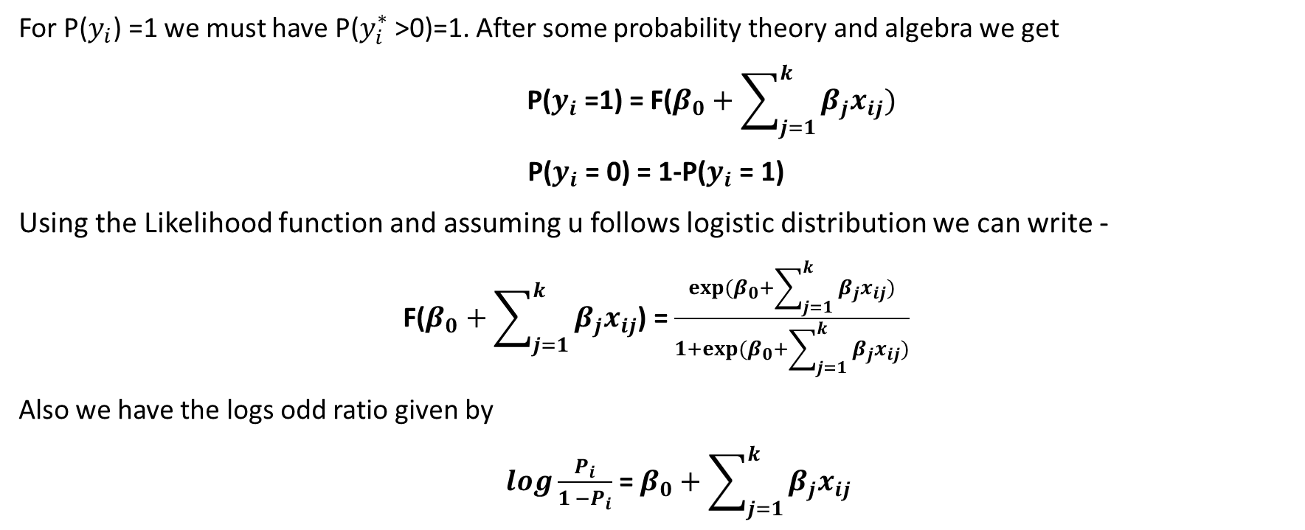
LOGIT MODEL
For P($y_{i}$) =1 we must have P($y_{i}^{∗}$>0)=1. After some probability theory and algebra we get
P($y_{i}$ =1) = F($β_{0}+\sum_{j=1}^{k}{β_{j}x_{ij}})$
P($y_{i}$ = 0) = 1-P($y_{i}$ = 1)
Using the Likelihood function and assuming u follows logistic distribution we can write -
F($β_{0}+\sum_{j=1}^{k}{β_{j}x_{ij}}$) = $\frac{exp⁡(β_{0}+\sum_{j=1}^{k}{β_{j}x_{ij}})}{1+exp⁡(β_{0}+\sum_{j=1}^{k}{β_{j}x_{ij}})}$
Also we have the logs odd ratio given by
$log\frac{P_{i}}{1 −P_{i}}$ = $β_{0}+\sum_{j=1}^{k}{β_{j}x_{ij}}$

Slide 5

TURNOVER RATE
The Turnover Rate reflects the number of employees hired to replace those who have left over a certain period. It is one of the most important factors for the success of a company as it reflects the overall health and stability of your company. Generally, the turnover rate is calculated with workforce data over the course of a year. It is the HR department who is responsible for conducting, recommending and implementing employee retention strategies during restructuring.
AIM : The objective of this paper is to use Logit Model in handling one such real world phenomena – Turnover Rate of a Company and with the help of logistic regression we will try to analyze and predict the turnover rate for a group of individuals.

Slide 6



Slide 7



Slide 8


Slide 9


Slide 10


Slide 11


Slide 14
In the ASK phase, Alexa tries to find out the what question she wants to ask or frame to make data driven decision making. Whenever an employee resigns from his current assignments, it is the responsibility of the HR to intervene immediately to find out the reasons which prompted the employee to resign so she must try to spot something unusual happening, identify connections and find a pattern.

Slide 15
Drivers of Employee Turnover
Work Satisfaction
Recognition
Stress
Environment
Demography
Leadership
Finally, she comes up with the questions: Which factors are responsible for such retention rate of employee and how to predict the retention behaviour of her existing employee and the one whom she shall recruit in future?

Slide 16
Alexa has the database of all the employees both existing and who have left, hence, she can use that for analysis as those data can be reliable and original.
For the analysis purpose dataset on IBM HR Analytics Employee Attrition & Performance has been taken by her. The data includes a total of 34 factors responsible for retention or attrition of an employee and 1470 observations.

Slide 17
In this phase she cleans the data such that there are no missing values in any observation.
The data taken includes factors which are categorical in nature :
Gender with values Male and Female which has been modified to 1 for Female and 2 for Male,
Marital Status has been given value 1 for Single, 2 for Married and 3 for others,
Department for which Sales are assigned 1, R&D is assigned 2 and HR is assigned to 3.
After such modifications Alexa turns her attention to divide the dataset into two section :
Train
70%
Test
30%

Slide 18
ANALYSE
Choose a model.
Run the regression using independent and dependent variables.
Check for the goodness of fit of the model.
Drop the insignificant variables/factors.
Repeat the regression and check for any improvement in the fit of the model

Slide 19
TABLE 1: Analysis of Maximum Likelihood Estimates
Parameter |  | Estimate | Standard | Wald | Pr > ChiSq
 |  |  | Error | Chi-Square
Intercept |  | 9.2763 | 1.008 | 84.6874 | <.0001
Age |  | -0.0338 | 0.0133 | 6.454 | 0.0111
EnvironmentSatisfaction |  | -0.3845 | 0.0896 | 18.3953 | <.0001
JobInvolvement |  | -0.6522 | 0.1381 | 22.2948 | <.0001
JobLevel |  | -0.5338 | 0.1391 | 14.7326 | 0.0001
JobSatisfaction |  | -0.3571 | 0.0899 | 15.7718 | <.0001
MaritalStatus |  | -0.8367 | 0.1479 | 32.0094 | <.0001
OverTime |  | -1.6656 | 0.2092 | 63.3877 | <.0001
RelationshipSatisfaction |  | -0.2127 | 0.0904 | 5.536 | 0.0186
WorkLifeBalance |  | -0.301 | 0.1363 | 4.8778 | 0.0272
YearsInCurrentRole |  | -0.1416 | 0.0404 | 12.2972 | 0.0005
YearsSinceLastPromotion |  | 0.1617 | 0.0422 | 14.6986 | 0.0001
DistanceFromHome |  | 0.0259 | 0.0121 | 4.598 | 0.032
NumCompaniesWorked |  | 0.1462 | 0.0404 | 13.1234 | 0.0003
ANALYSE

Slide 20
Having Trained the data, she tests the remaining observations to check the accuracy of the fitted model.
ANALYSE
Frequency Percent Row Pct Col Pct | Table 2: Attrition by Attrition_pred
 | Attrition | attrition_pred
 |  | 0 | 1 | Total
 | 0 | 370 83.9 98.4 87.26 | 6 1.36 1.6 35.29 | 376 85.26
 | 1 | 42 8.24 83.08 12.74 | 23 6.49 16.92 64.71 | 65 14.74
 | Total | 424 96.15 | 17 3.85 | 441 100

Slide 21
Alexa then shares the results and her intuition of the analysis with her team so as to get some valuable insights on the entire modelling and to correct if any part went wrong.

Slide 22
Finally, the entire team has to act upon the analysis by recommending policies to keep their employee attached to their company. Seeing the results, the team may decide on following policies:
Considering distance from home as one major factor, employee from far places should be given some accommodation facilities near the office.
Existing employee should be given recognition in terms of promotion or salary hike on the basis of their performance which can bring about a competitive environment leading to benefits for the company.
At the time of recruitment an individual who has switched from different companies should be given less priority.
Regular checks should been done to collect feedbacks of the employee to get an idea where the problem persists.

Slide 23
CONCLUSION
Applied Economics often offer us situations where a binary or categorical dependent variable is related to various explanatory variables. Logistic model is a commonly used algorithm for solving such binary classification problems Like all regression analyses, the logistic regression is a predictive analysis. Thus it helps in solving high-end business problem among which we used Turnover Rate in this paper.
The entire analysis of this paper gives us an insight that:
“Start the retention process when the person is still open to staying and not after they have already told you they are leaving”
---Jeff Weiver

Slide 24
THANK YOU

